Slide 1


MBSE Library Overview
Parker Lee,
SSEP Intern, V52

Slide 2
Program Goals
We have been interested in bi-directional code translation
Code to model
Model to code
“Model” in this case is a digital representation, not UML/SySML
e.g. {Codebase: [‘Classes’: {‘FirstClass’: {Functions …. } } ] }
This research is leading to a couple of functional capabilities that have multiple use cases:
FY23 NISE proposal: MBSE Automation Tool - Code to Model
Combat System Behavioral Model
Tool output
Lab diagraming from data

Slide 3
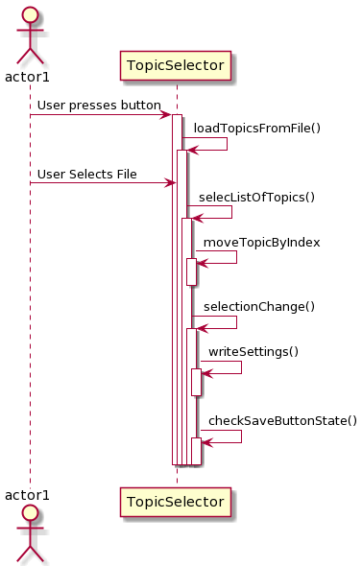
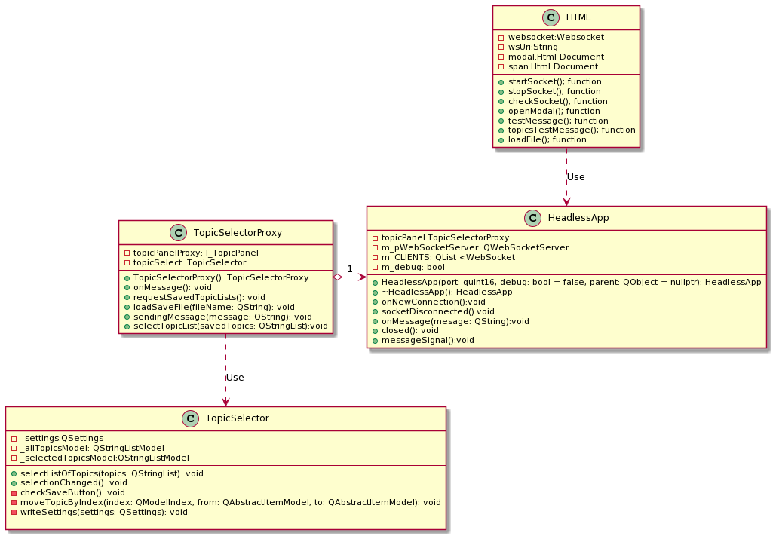
Purpose
Model Based Systems Engineering (MBSE) is the formalized application of modeling to support system requirements, design, analysis, verification and validation activities
Important to understanding how a system works
A way to visualize code or data
Saves time for onboarding for those new to a system
BUT
Takes time to create and is tedious
Nobody enjoys creating them
Week 2 of internship
3-4 hours of work

Slide 4
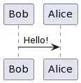
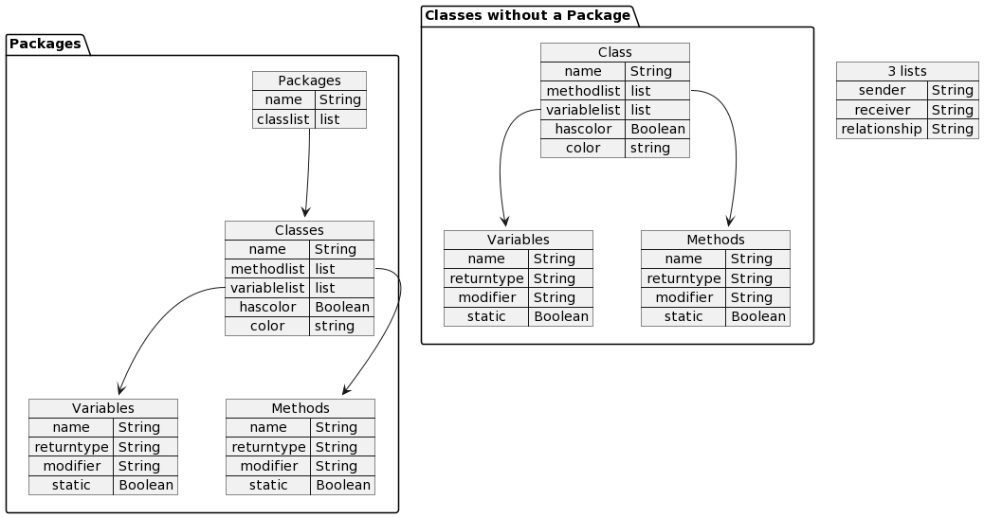


Introduction
MBSE Library
Python library to create MBSE models and visualized using PlantUML
PlantUML outputs .png/.svg images using its own syntax
Models created digitally and outputted to .png
Supports class, sequence, and communication diagrams
Code Diagrams and Linear Diagrams two branches
Input file or internally through functions
Bob->Alice : Hello!
Digital Model
Creates
Visualized
Python MBSE Library
PlantUML

Slide 5
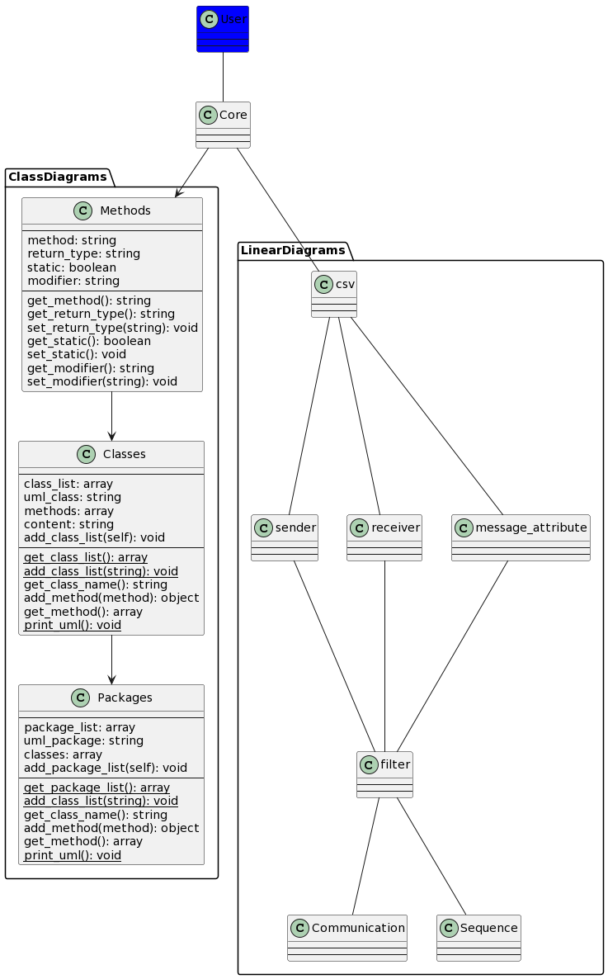
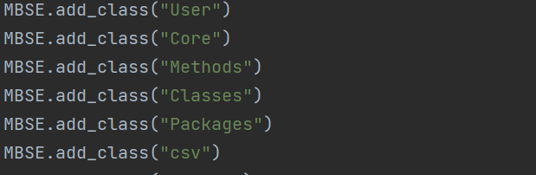
Code Diagrams
Contains packages, classes, and methods
Built within the library
Add methods and variables to classes
Relationships between classes
Add classes to packages
Can add color
Code diagrams widely available in tools, but do not give the user the ability to “zoom” in

Slide 6

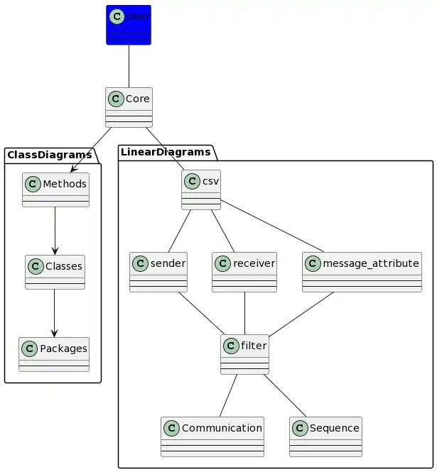
MBSE Library
Package Diagrams

Slide 7
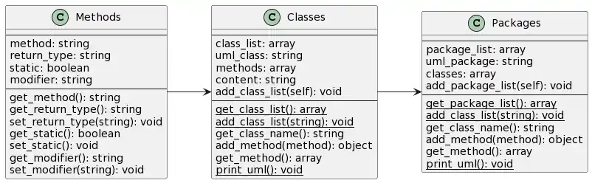
MBSE Library
Can “zoom” from package diagrams into class diagrams

Slide 8
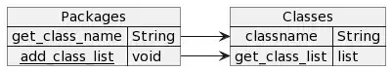
MBSE Library
Can “zoom” from class diagrams into method diagrams

Slide 9
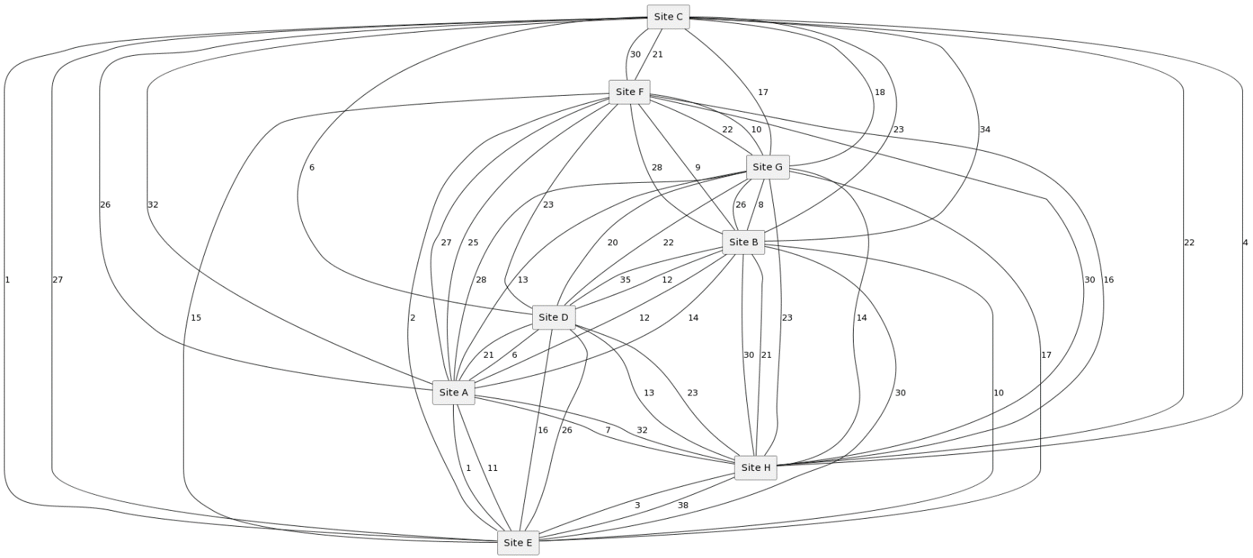
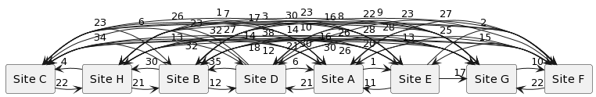
Linear Diagrams
Raw data output
Can be done with large amount of data
Communication and Sequence Diagrams
File Input

Slide 10
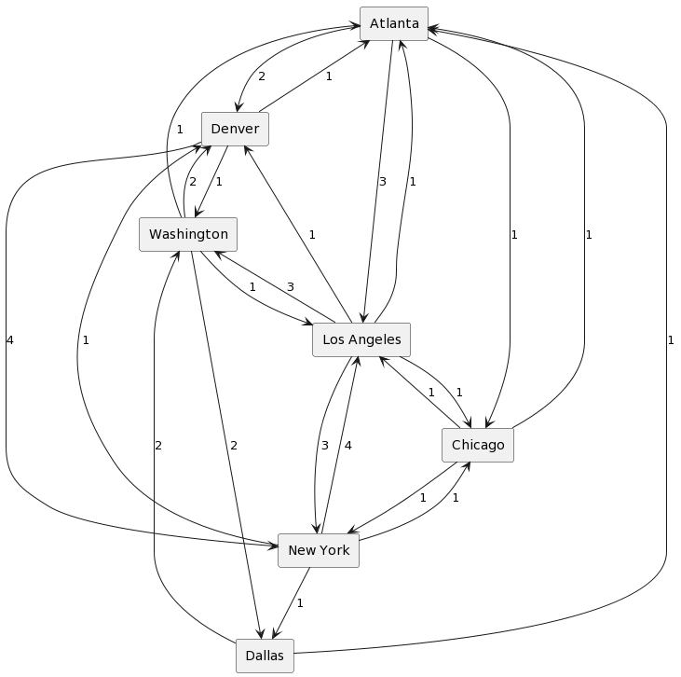
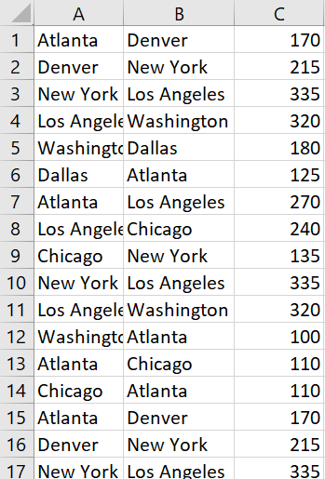
MBSE Library
CSV File Input
Sender | Receiver | Message
A plane’s past 40 stops with distances between nodes
Atlanta,Denver,170
Denver,Washington,195
Washington,Los Angeles,320
Los Angeles,Chicago,240
(…)

Slide 11
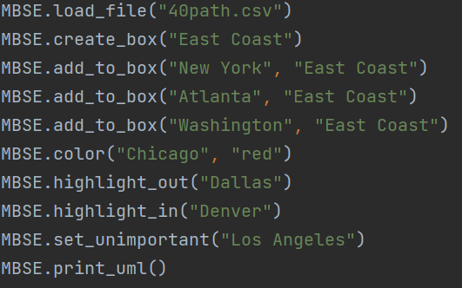
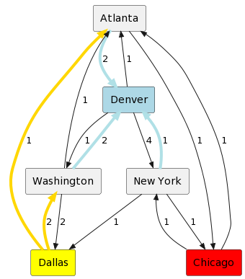
MBSE Library
Can filter unwanted data, highlight or color certain nodes

Slide 12
MBSE Library
Same data and model, just filtered

Slide 13
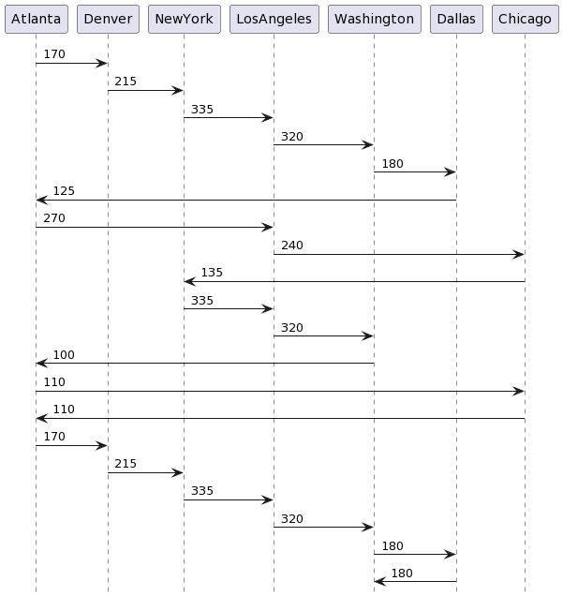
MBSE Library
Sequence diagrams
Same data, different way of demonstration
Focused on Order

Slide 14
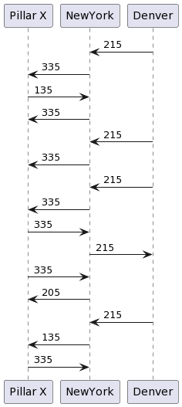
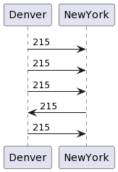
MBSE Library
Can ‘zoom’ into two nodes and look at connections between an important and secondary node

Slide 15
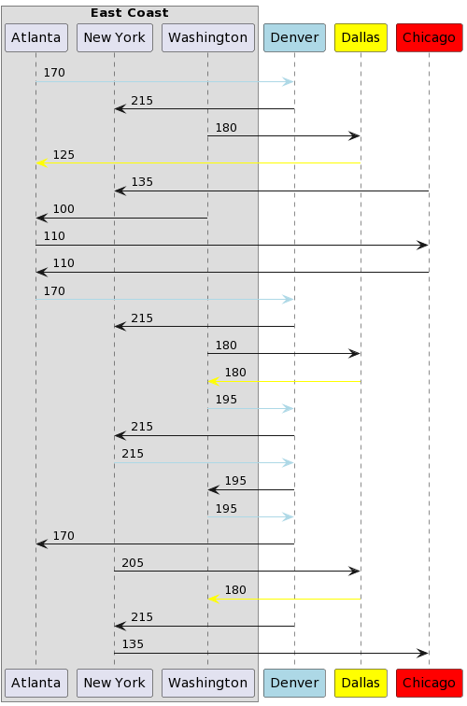
MBSE Library
Blocks: Combat system major components
Pillars: Individual CS programs

Slide 16
SDAMT
Structured Data Analysis and Modeling Tool (SDAMT)
GUI based application utilizing the MBSE library
Allows user to save and edit digital models in real time
Can be done easily for everyone
No programming internally to the library
Written in Python using tkinter

Slide 17
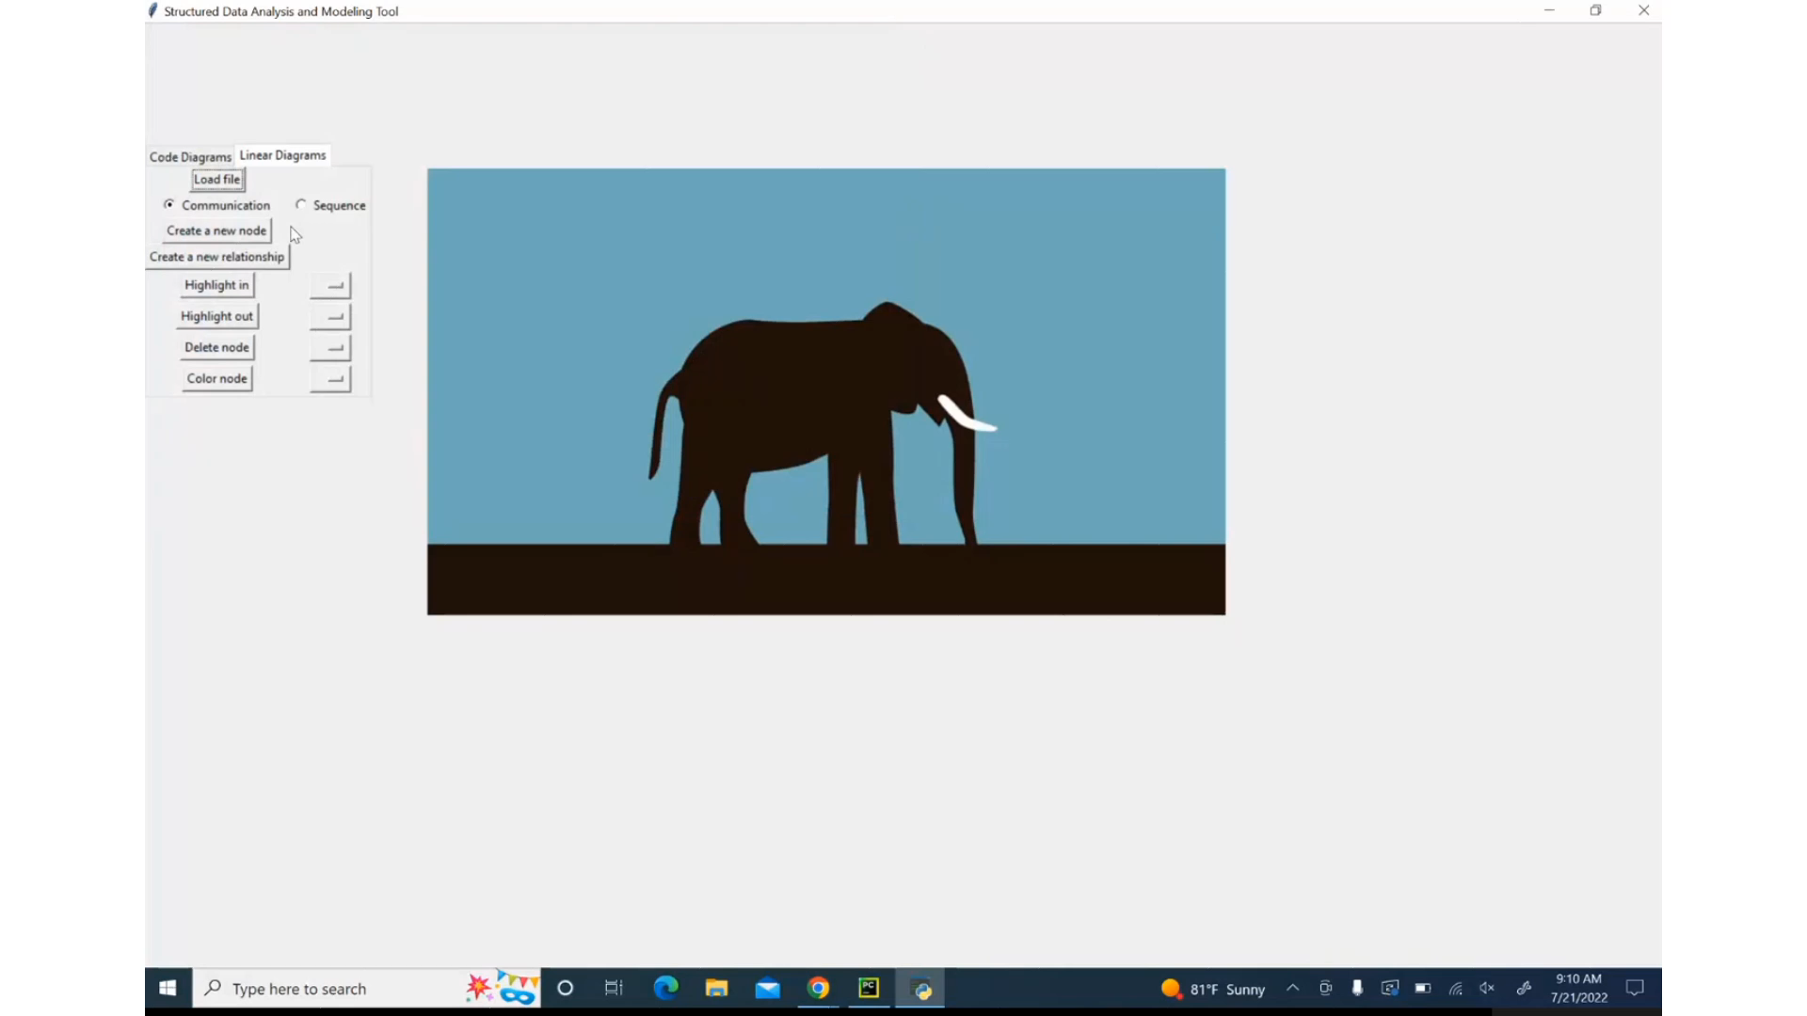
SDAMT

Slide 18
Conclusion
MBSE Library allows the user to digitally create and edit a model
Can zoom in and out of a model
Can filter unwanted data
Can highlight specific data
Save digital model that can be run through library again
Can be attached to various tools
Use output through SQM to output code diagrams
Read test data and output behavioral model
Read structural data and output package diagram
Server allows for remote MBSE building from various tools and languages

Slide 19

Questions?

